Slide 1

#CANWETALK
YOUR VERY PERSONAL AGENT TEDDY
Notes:
Hannah
Hello Everybody!
Let me introduce ourselves first.
We are computing students from BCIT and my name is Hannah, Elly, and Amy.
Our project for today is called #CANWETALK.
#CANWETALK is basically a website where users could communicate through Google Assistance.
Teddy, the one and only special agent that we created, will ask users for data.
The reason why we named our project #CANWETALK is because you know how we use hashtags on social medias to spread the important messages right? Similarly, our main goal was to spread the message that theres nothing wrong with feeling lonely and depressed and that we (Teddy) would be always there to help you to get over it.

Slide 2
15% of Canadians suffer from depression
Lack of activity
Sleeping disorder
Lack of social contact
Canadian Medical Association Journal: Major depression is a significant factor of early death for both men and women
Reference: https://www.medicalnewstoday.com/articles/319834.php
Notes:
Hannah
So, What are we trying to solve here?
Around 15% of Canadians suffer from depression right now. One of the main reasons for the depressions are: lack of activity, sleeping disorder, and also lack of social contact. The studies from Canadian Medical Association Journal shows that the depression is a significant factor of early death for both men and women.

Slide 3
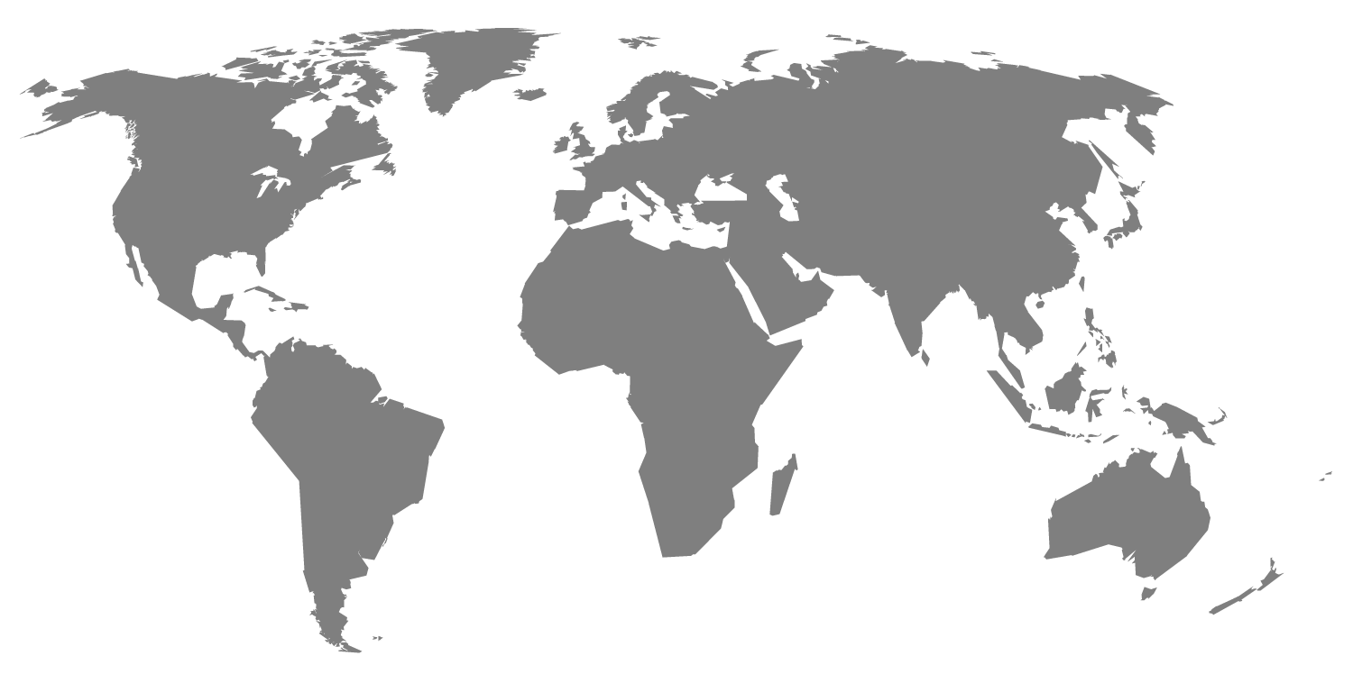
People suffering from depression
10% of Women
5% of Men
More than 3.2 million
Reference: https://cmha.ca/about-cmha/fast-facts-about-mental-illness
Notes:
Hannah
Who’s going to be our potential users?
In Canada, the research from cmha shows that 10% of Women and 5% of Men are suffering from depression which makes it 15%. 15% might seem small, but let me ask you this random question. Do you guys know anyone around who has Blood type B? In Canada, people who has blood type B only makes up to 9% of the whole population. WHICH MEANS, people who are suffering from depression

Slide 4
Current solutions for depression
Waiting Time
Counselling
Numbness
Notes:
Amy

Slide 5
4 Major solutions for depression
Relationship
Rest
Movement
Diet
Notes:
Amy

Slide 6
“ONE STEP AT A TIME, FOCUS ON THE BASICS”
Notes:
Amy
왜 자는시간, 운동시간 기록하는게 우울증에 도움 되는지 설명

Slide 7

Walkthrough
Demo
Notes:
Elly

Slide 8
OUR VISION
Google Authentication
Statistic
Mobile app
Notes:
Elly
Advance our area of conversation.

Slide 9
Thanks!
Any questions?
Notes:
Elly

